Slide 1



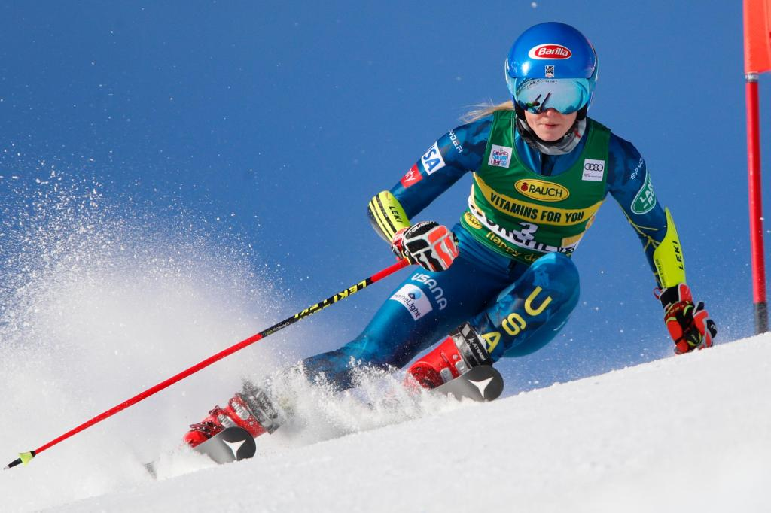



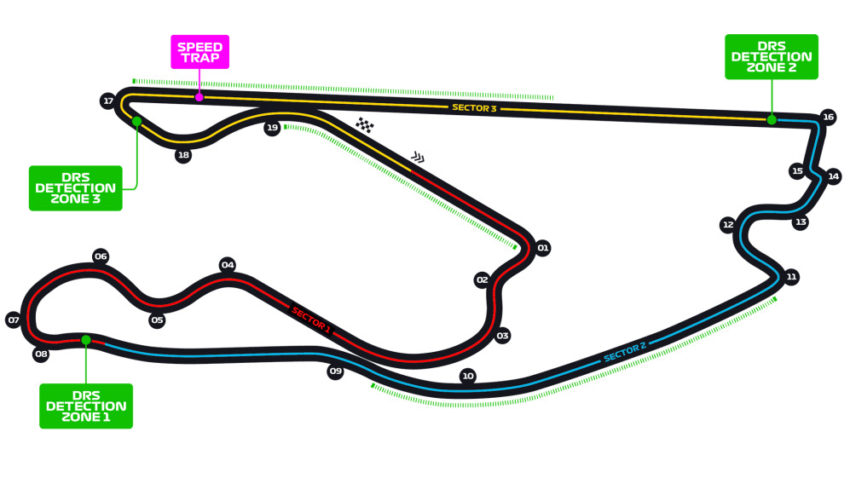
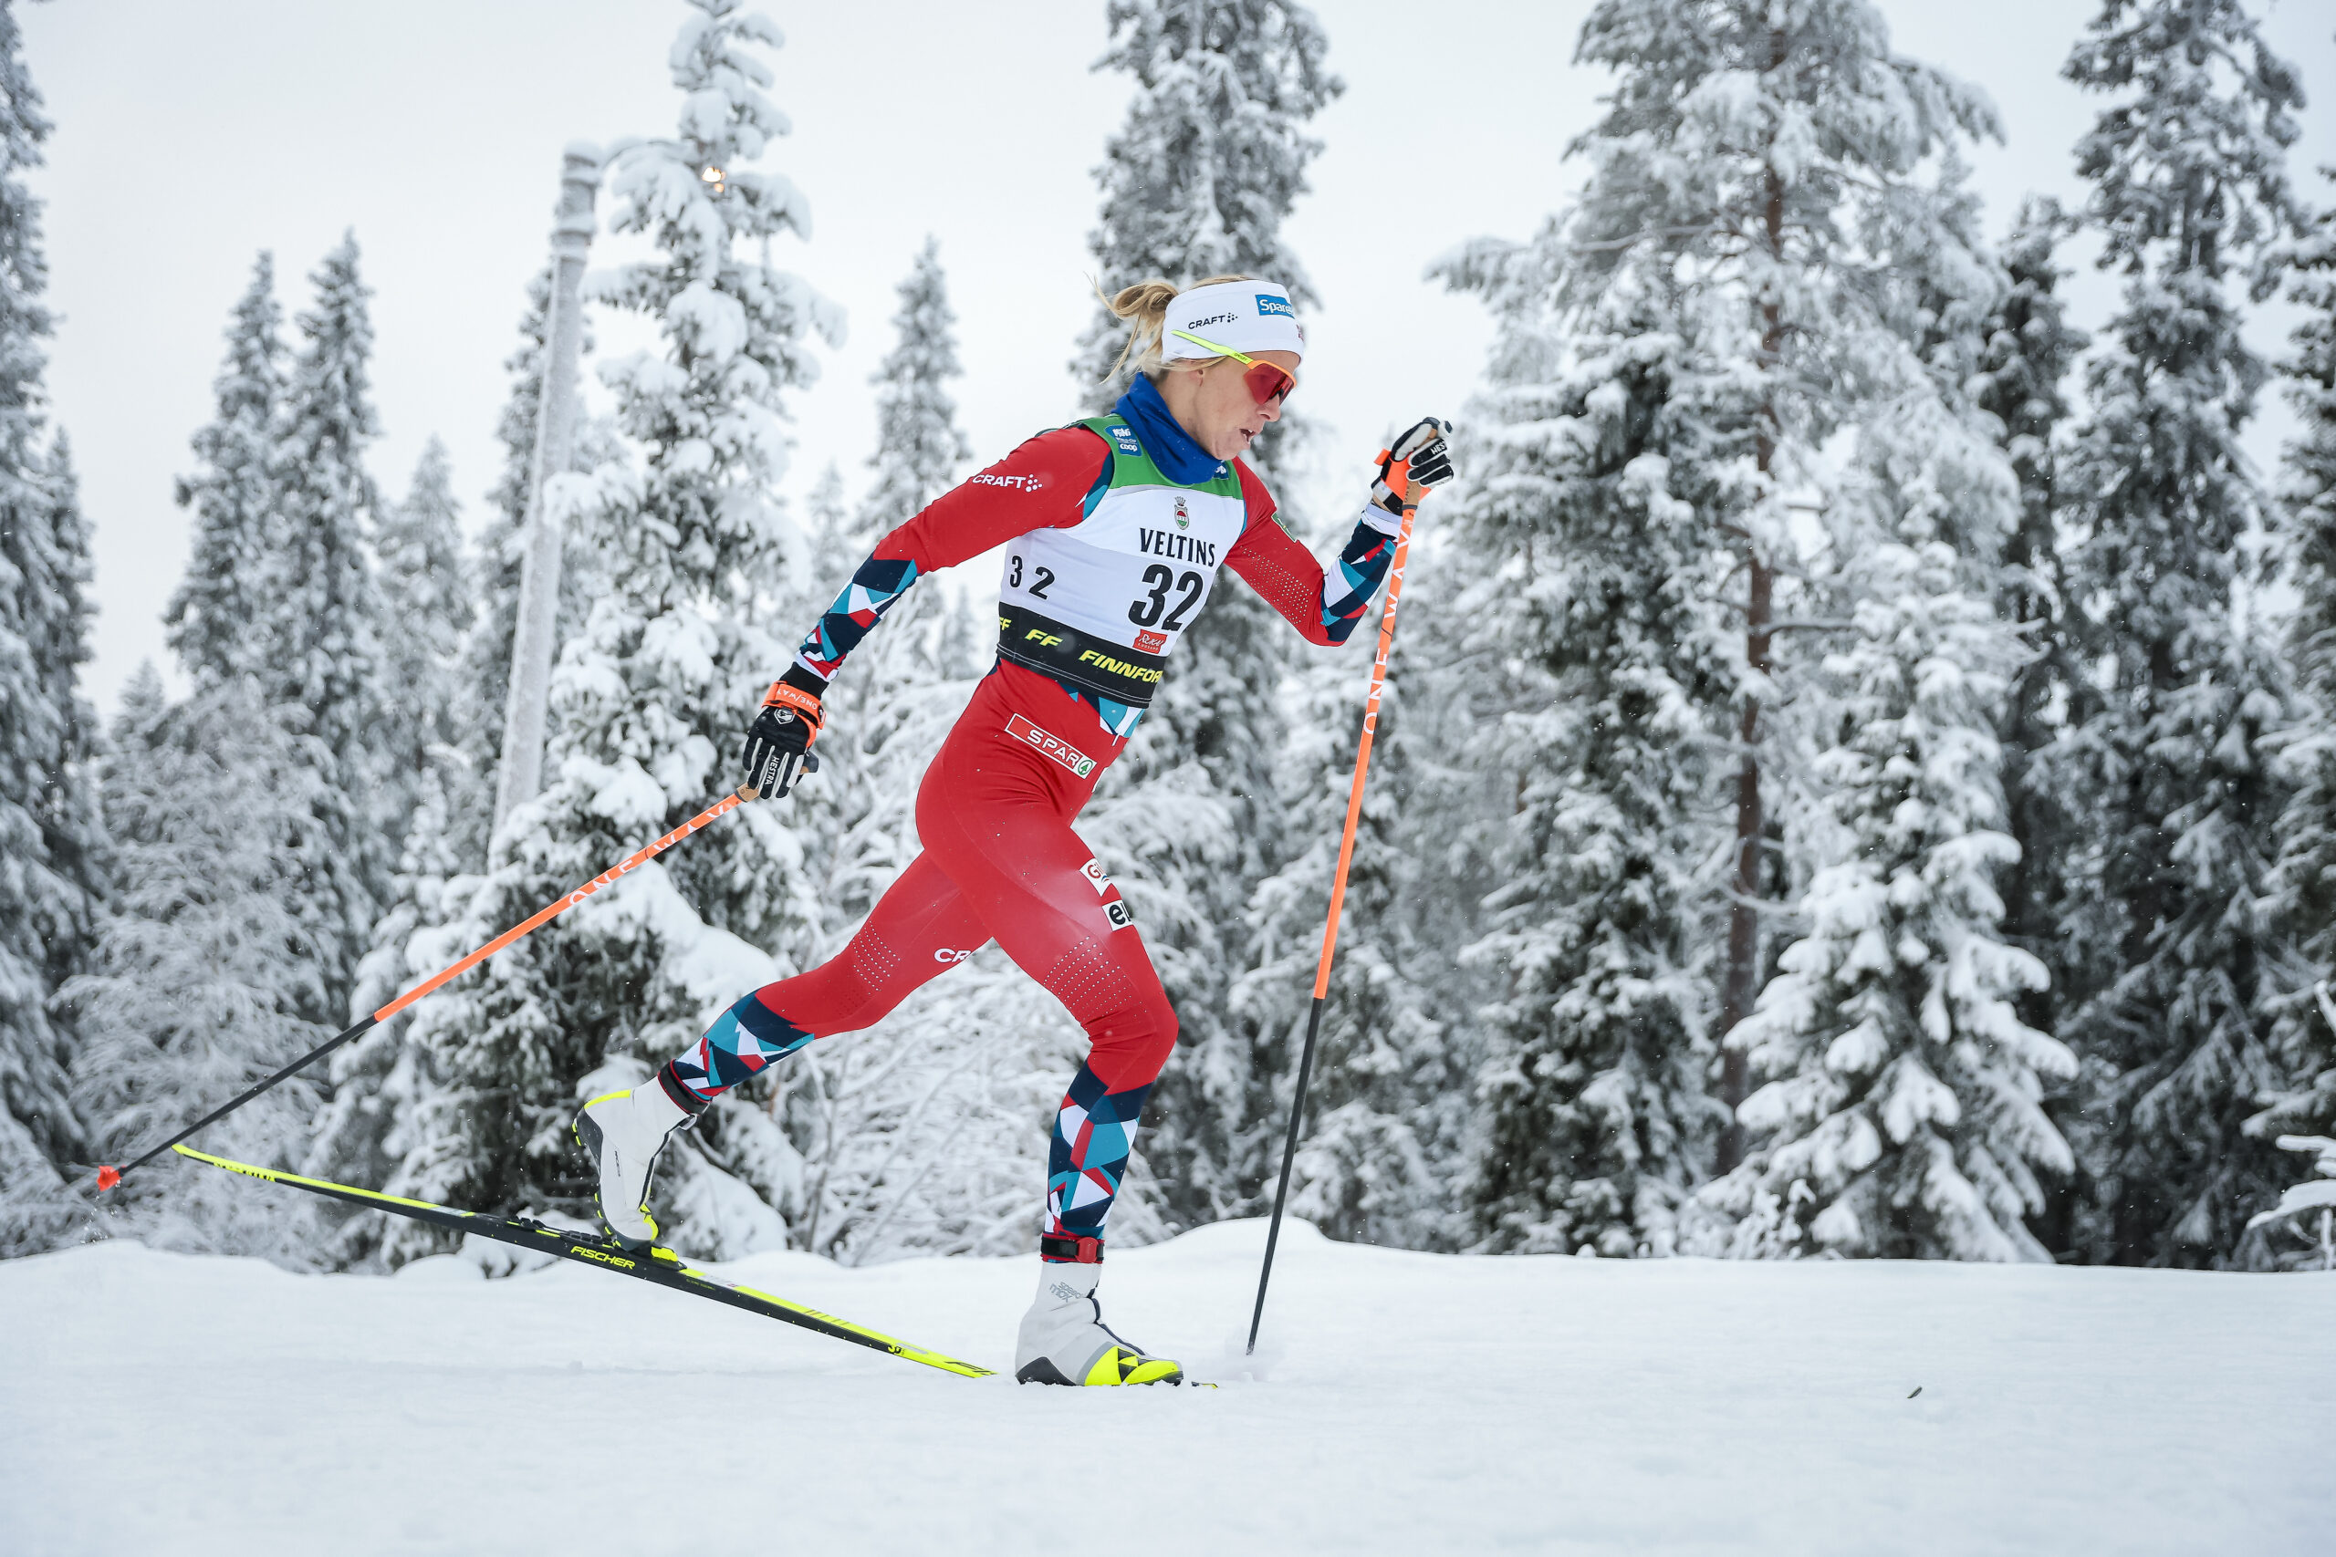
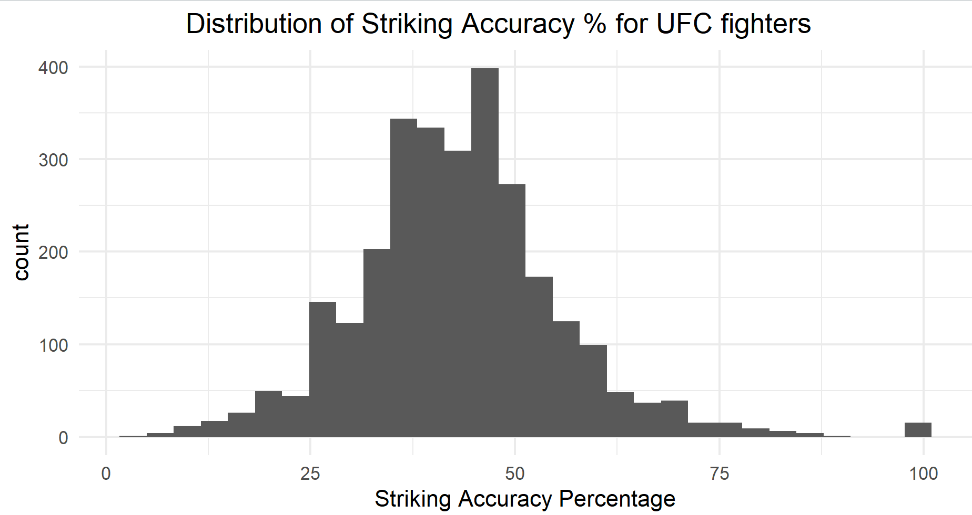

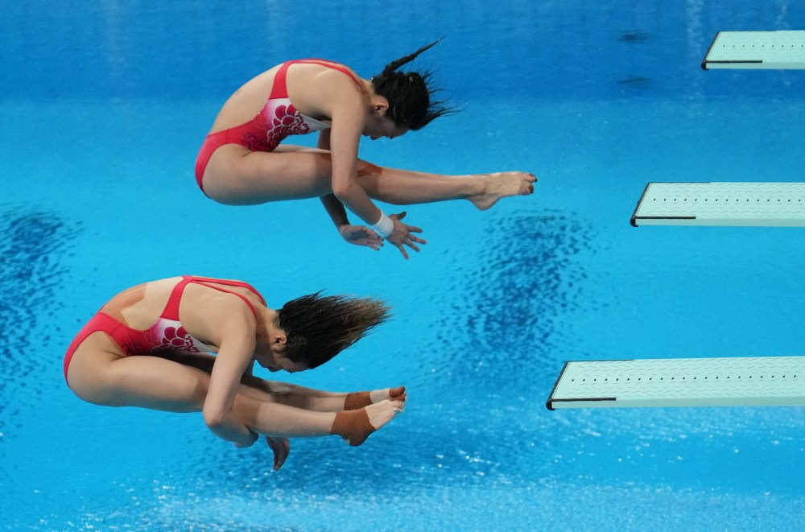


Statistics Resources with Non-Traditional Sports Data
Department of Mathematics, Computer Science, Statistics, and Data Science
Advisors: Professors Robin Lock, Michael Schuckers, Ivan Ramler, A.J. Dykstra
What is SCORE?
The SCORE Network is an NSF funded organization that…
Develops and distributes Sports Content for Outreach, Research, and Education (SCORE)
Seeks to implement an educational framework based on real-world problems and applications
Increases student likelihood to be engaged in the classroom
The St. Lawrence chapter of SCORE focuses on using non-traditional sports data to develop introductory- level statistics resources for educators.
Olympic Medals: Data Cleaning and Summarization
Giant Slalom: Paired Data and Data Tidying
Data Info: Alpine ski data scraped from FIS website containing information on two runs of women's GS at Mont Tremblant
Module Goals:
Use paired data to perform a test for difference in means, find a confidence interval, obtain summary statistics, and interpret findings
Clean an untidy data set using tidyr and dplyr
Data Info: Olympics info about both medals and athletes
Module Goals:​
Understand what is considered tidy data
Use R to clean and format data correctly for future use
Eric Seltzer (Data Science and Finance)
Emilia Agostinelli (Statistics)
UFC: The Normal Distribution
Data Info: Defense and striking statistics for each fighter that competed in the UFC from 1993 to 2021.
Module Goals:
Using the Normal distribution in a real-world application
Identifying proportions, quartiles and ranges
Using StatKey given a mean and standard deviation
Formula 1: Histograms and Outliers
Nordic Ski: Randomized Block and dplyr
Data Info: Data scraped from the FIS website about a women's 10k race in Norway. The dataset has 61 skiers with 20 variables at 1.3k, 4.3k, 7.5k, and 10k intervals
Data Info: Lap times for each driver (and constructor) that participated in the 2023 F1 Miami Grand Prix
Module Goals:
Understand histograms and outliers and their relevance in statistical analysis.
Highlight use of summary statistics in outlier detection
Module Goals:
Use randomized block design to assess difference in mean speed based on skier and distance interval
Use dplyr to calculate the speed of each skier at each distance
Brendan Karadenes (Data Science)
Norah Kuduk (Computer Science and Statistics)
Abigail Winston Smith (Data Science and History)
Diving: Difference in Means Hypothesis Tests
Data Info: Diving results from the 2022 FINA Junior World Championships from women divers aged 16 – 18.
--
Module Goals:
Conduct difference in means hypothesis tests to test if there is a significant difference in mean points scored between divers of different ages
Practice conducting hypothesis tests in R or by hand.
League of Legends: Chi-squared Distribution
SCORE Data Repository
Datasets in the SCORE repository come from a variety of sports, and consist of…
The motivation behind using the data
A description of the dataset (size and variables)
A variety of questions that could be answered using the data
Each of the datasets highlighted in
the previous sections has been published
in the SCORE Data Repository to be
used internationally
Data Info: Analyzing synergistic relationships between ADC and Support champions in League of Legends.
Module Goals:
Utilize Chi-Squared analysis to explore significant relationships between top and bottom five most popular champions
Understand use of Chi-Squared to identify statistical significance
Emma Deering (Data Science and Geology)
George Charalambous (Data Science)
Notes:
Text-size:
The Main Title should be at least 100 points (4 cm high)
Subheadings should around 50 points (Between 1.5 - 2 cm high)
Body text is most easily read when it is 25 points (Between 0.5 - 1 cm high). The absolute minimum for text is 18 points.
The title of your poster should appear at the top in large letters.
People will not read a lot of text, and certainly won't read standard journal-sized text.
Printed text should be very brief, or most people will walk away.
Studies show that text written in all capital letters is hard to follow; it is better to use bold print than all caps.
Bullets may be helpful in summarizing information.
Divide the contents of your poster into appropriate sections.
Titles to highlight different sports being represented
Bullet points for the SCORE and data repository sections
This project funded by NSF grant

